Slide 1
T1-T2 mapping of seeds
NMR and MRI Application in Biotechnology

Slide 2
Seeds
Seeds are a basic source of food for both man and animals. But they are also an important source of medicine and drugs.
The main composition of seeds are: lipids and fatty acids, lignocellulose and starch complexes, a minor content of vitamins and minerals and a small amount of water.

Slide 3
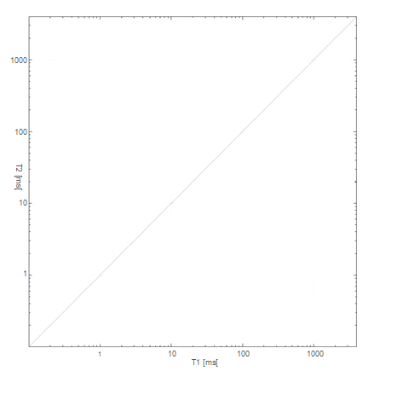
Demonstration of 2-D T1-T2 proton relaxation Dictionary
Fatty compounds
Porosity decrease
Free sugars
Biofilm Epoxy
Hydrated surface highly amorphous
Low-hydrated sub-surface crystalline
Hydrated sub-surface amorphous
Semi-hydrated sub-surface
Highly Crystalline
Para Crystalline
Amorphous
Crystalline decrease

Slide 4
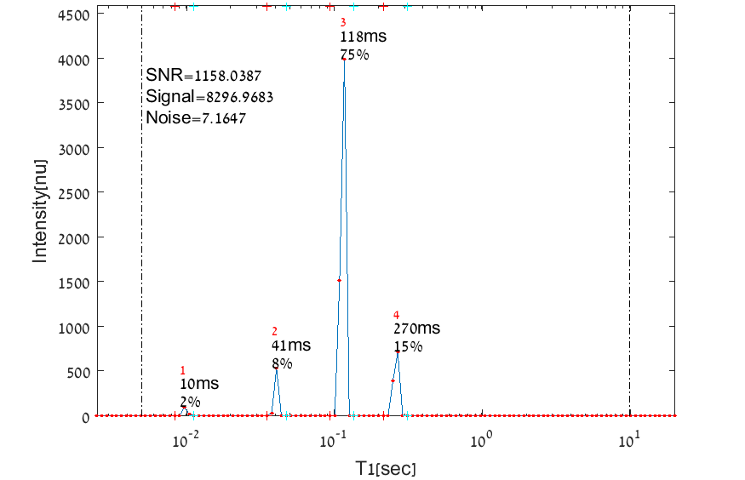
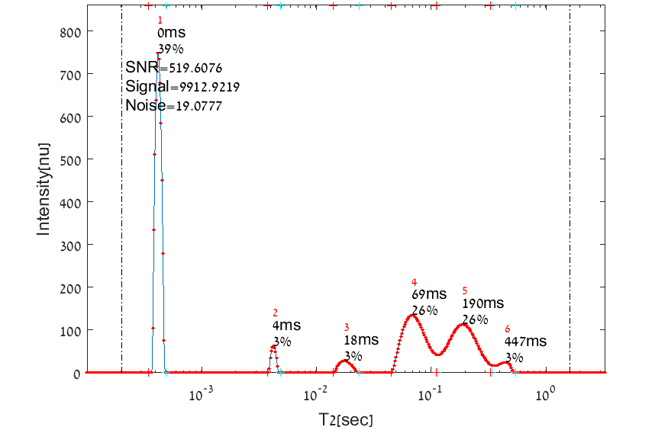
1D relaxation time spectra of hummus seed
T1 relaxation time spectrum of hummus seed
T2 relaxation time spectrum of hummus seed

Slide 5
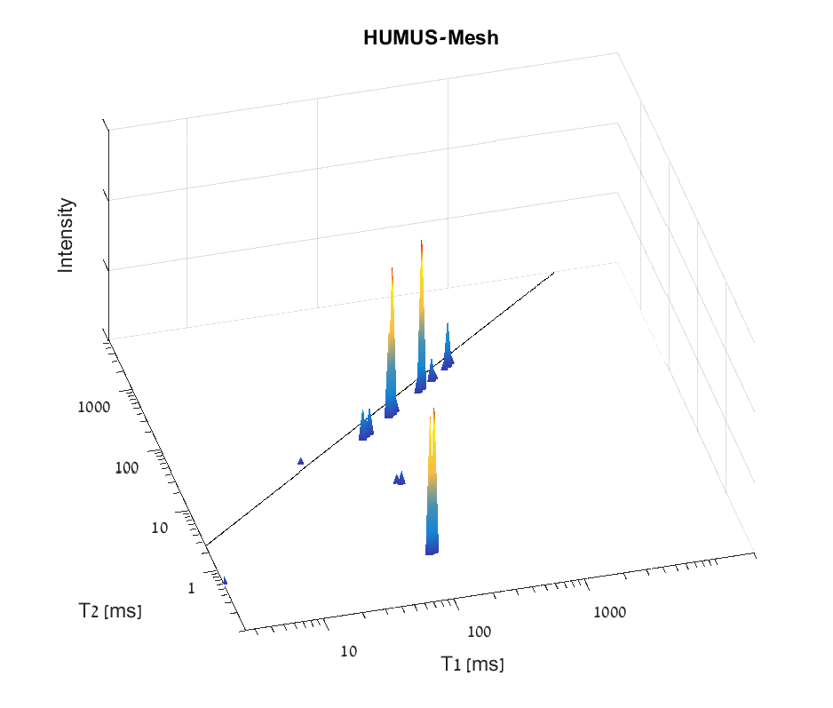
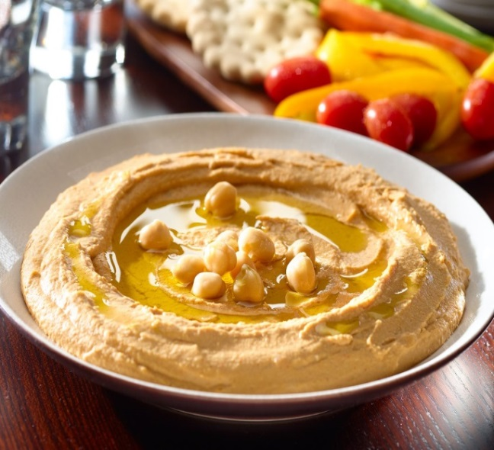
2D relaxation time spectrum of hummus
Nutritional Table (100g)
23.6g | Total Fat
3.5g | Saturated
9.9g | Monounsaturated
8.9g | Polyunsaturated
35.2g | Total Carbohydrate
14.8 | Dietary Fiber
- | Sugar
19.4g | Protein

Slide 6
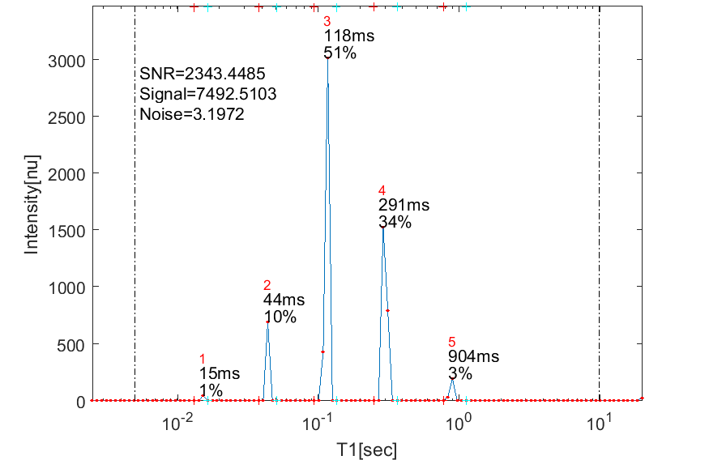
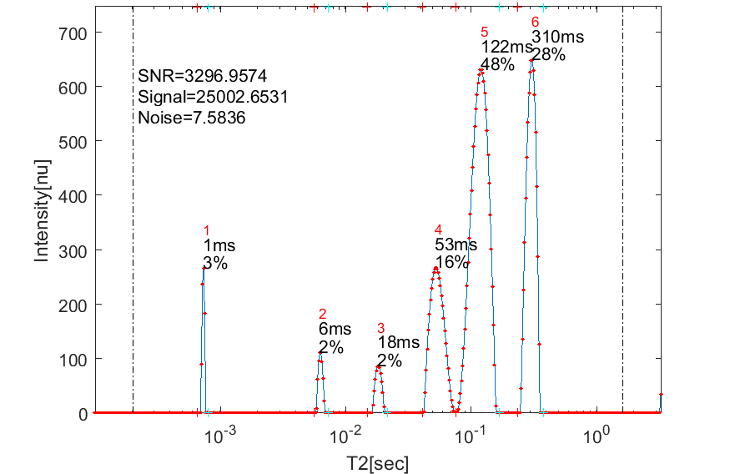
1D relaxation time spectra of almonds
T1 relaxation time spectrum of almonds
T2 relaxation time spectrum of almonds

Slide 7
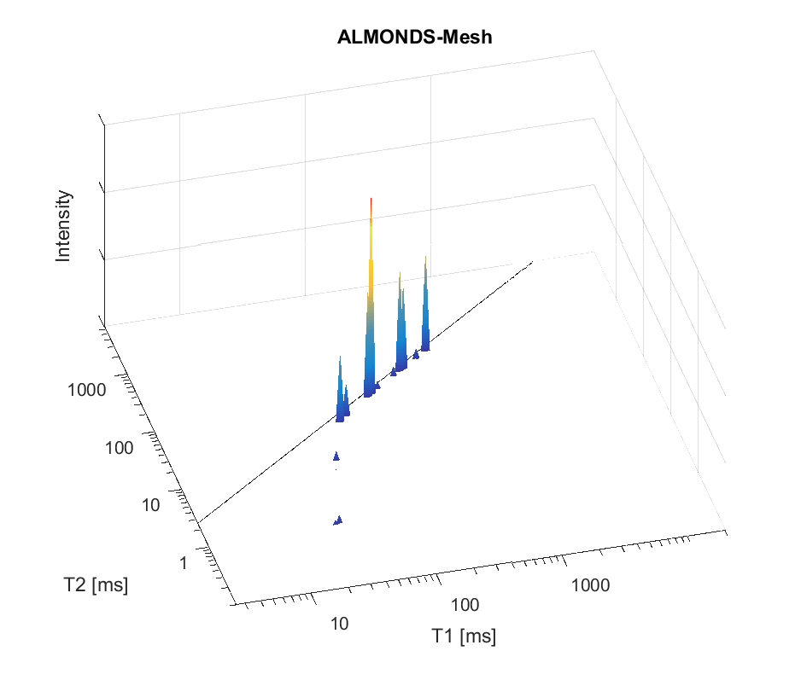
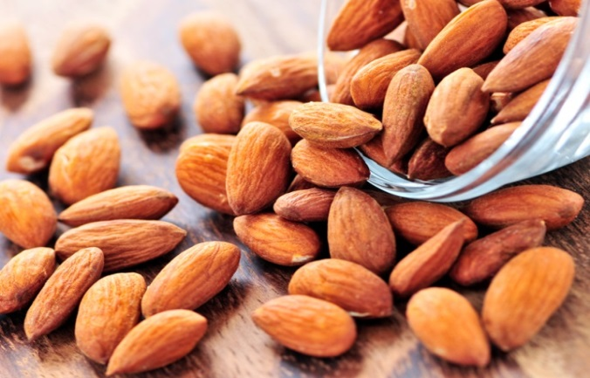
2D relaxation time spectrum of almonds
Nutritional Table (100g)
49g | Total Fat
3.7g | Saturated
31g | Monounsaturated
12g | Polyunsaturated
22g | Total Carbohydrate
12g | Dietary Fiber
3.9g | Sugar
21g | Protein
8g | Other constituents

Slide 8
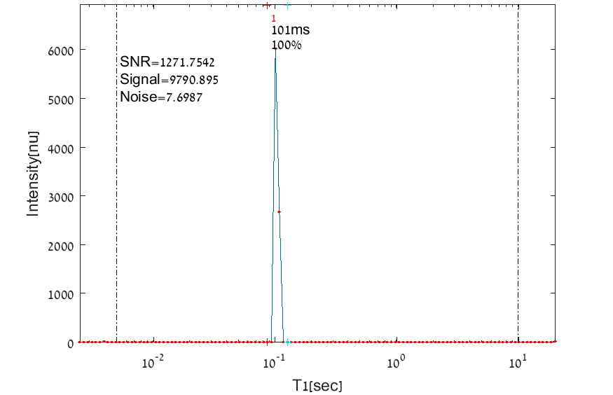
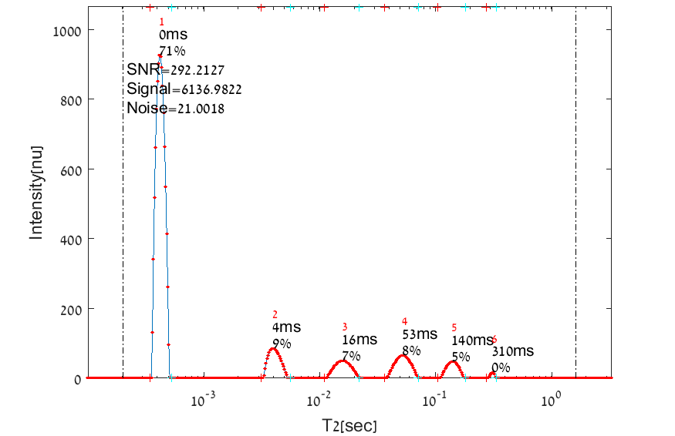
1D relaxation time spectra of lentils
T1 relaxation time spectrum of lentils
T2 relaxation time spectrum of lentils

Slide 9
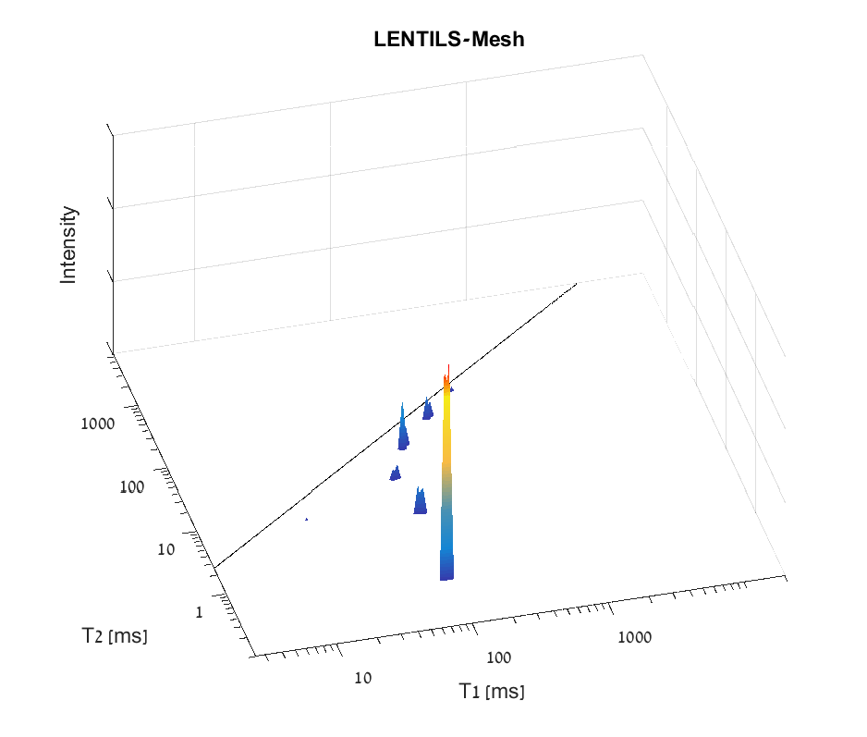
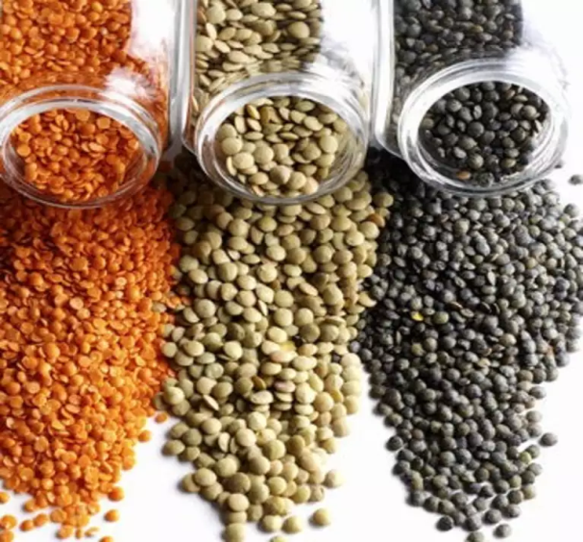
2D relaxation time spectrum of lentils
Nutritional Table (100g)
1g | Total Fat
63g | Total Carbohydrate
10.7g | Dietary Fiber
2g | Sugar
25g | Protein
8.3g | Water
2.7g | Other constituents

Slide 10
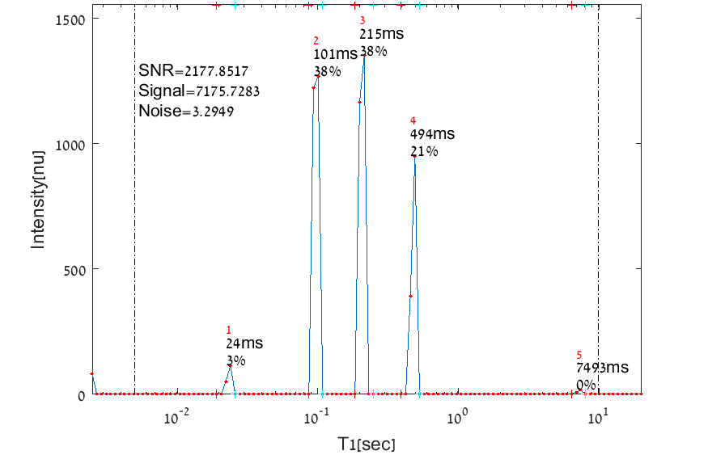
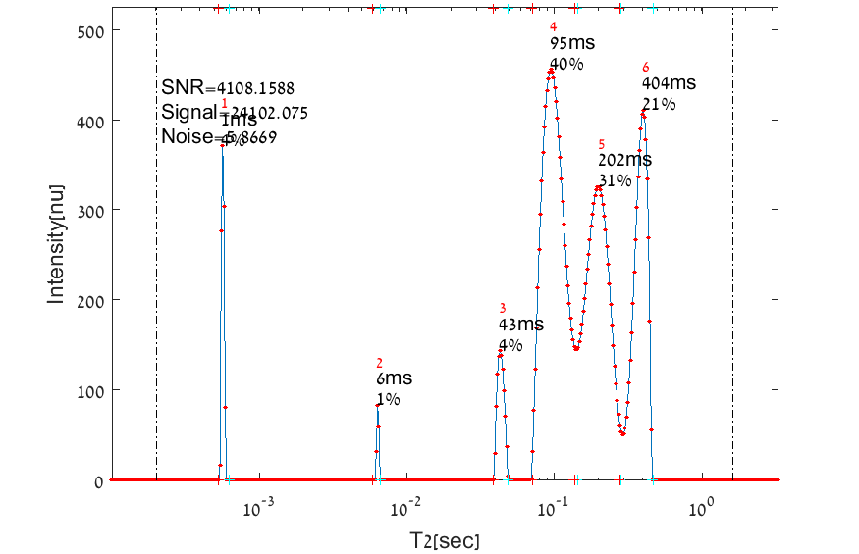
1D relaxation time spectra of sesame
T1 relaxation time spectrum of sesame
T2 relaxation time spectrum of sesame

Slide 11
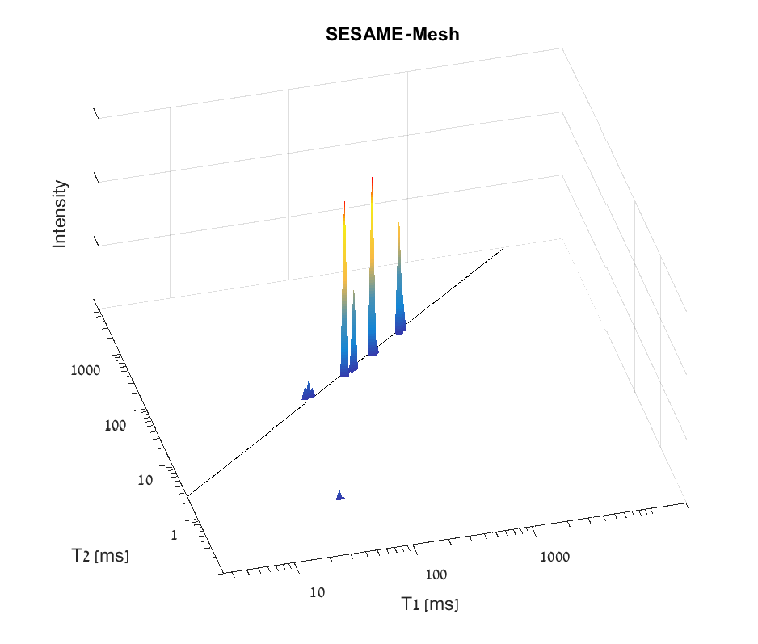
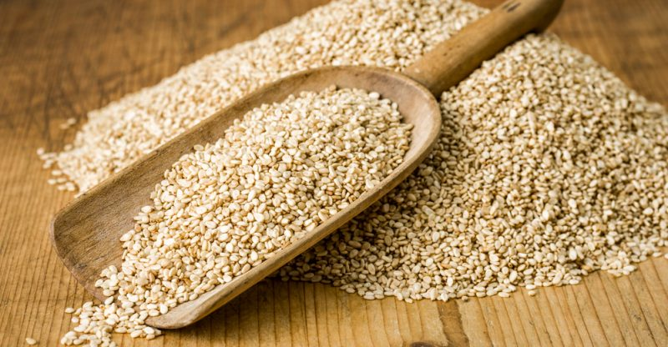
2D relaxation time spectrum of sesame
Nutritional Table (100g)
50g | Total Fat
7g | Saturated
19g | Monounsaturated
22g | Polyunsaturated
23g | Total Carbohydrate
12g | Dietary Fiber
0.3g | Sugar
18g | Protein
9g | Other constituents

Slide 12
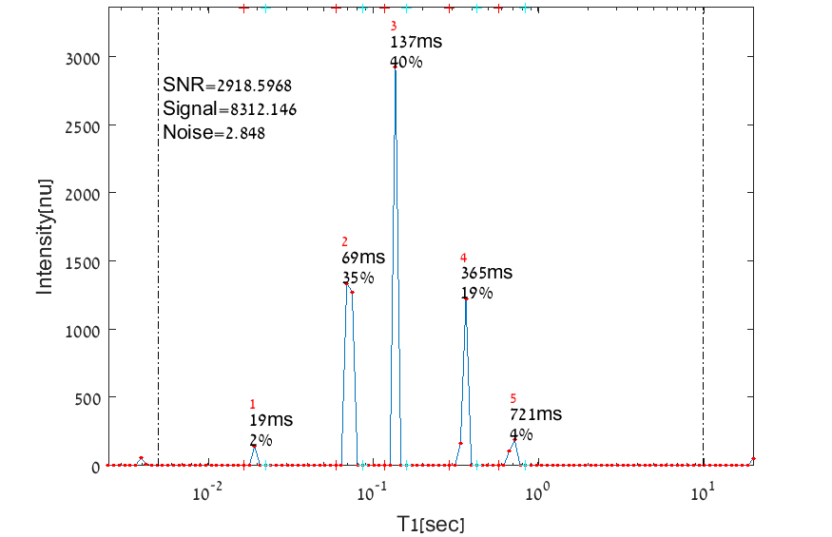
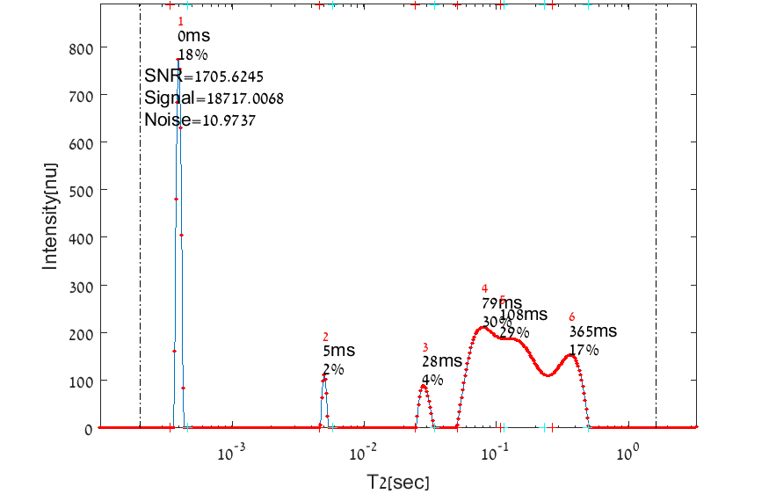
1D relaxation time spectra of soya
T1 relaxation time spectrum of soya
T2 relaxation time spectrum of soya

Slide 13
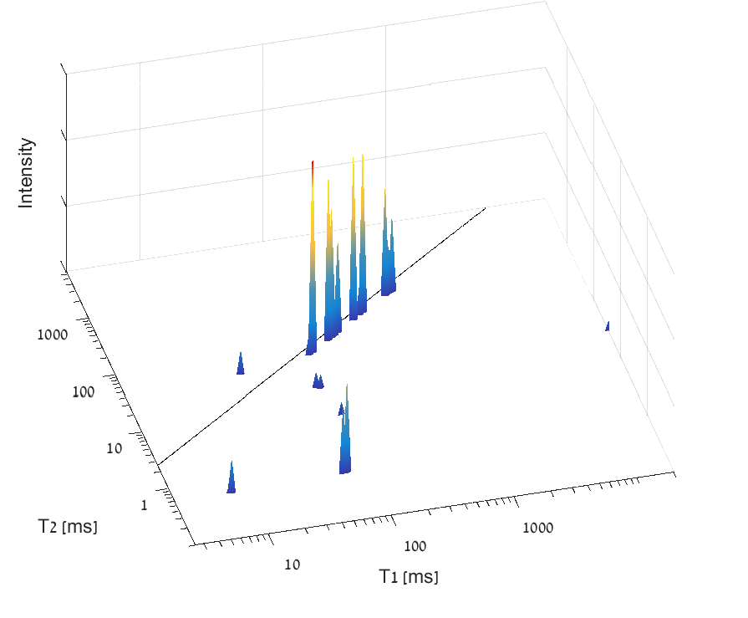
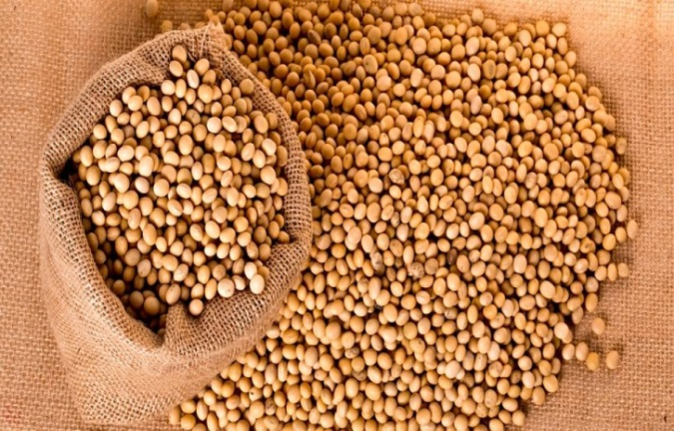
2D relaxation time spectrum of soya
Nutritional Table (100g)
19.94g | Total Fat
2.884g | Saturated
4.404g | Monounsaturated
11.255g | Polyunsaturated
30.16g | Total Carbohydrate
9.3g | Dietary Fiber
7.33g | Sugar
36.49g | Protein
8.54g | Water
4.87g | Other constituents

Slide 14
Contact Information
Prof. Zeev Wiesman: wiesman@bgu.ac.il
Maysa Resende: mteixeiraresende@gmail.com
Dr. Janna Abramovich: janna@bgu.ac.il
Shosh Kravchick: kravch@bgu.ac.il
Plant Lipid Biotechnology Lab phone number: 074-7795272

